Slide 1
React Js Intro
Notes:
Add or change image:
Right click on image >> Format Picture >> Fill Tab >> Picture or texture fill >> File button >> Choose your Image

Slide 2
React Intro
ReactJS is a declarative, efficient, and flexible JavaScript library for building reusable UI components. It is an open-source, component-based front end library responsible only for the view layer of the application.
It was created by Jordan Walke, who was a software engineer at Facebook. It was initially developed and maintained by Facebook and was later used in its products like WhatsApp & Instagram. Facebook developed ReactJS in 2011 in its newsfeed section, but it was released to the public in the month of May 2013.
Most of the websites are built using MVC (model view controller) architecture. In MVC architecture, React is the 'V' which stands for view, whereas the architecture is provided by the Redux or Flux.
A ReactJS application is made up of multiple components, each component responsible for outputting a small, reusable piece of HTML code. The components are the heart of all React applications.
To create React app, we can write React components that correspond to various(Different) elements. We can organize these components inside higher level components which define the application structure.
For example, we take a form that consists of many elements like input fields, labels, or buttons. We can write each element of the form as React components, and then we combine it into a higher-level component, i.e., the form component itself. The form components would specify the structure of the form along with elements inside of it.

Slide 3
React History
Current version of React.JS is V18.0.0 (April 2022).
Initial Release to the Public (V0.3.0) was in July 2013.
React.JS was first used in 2011 for Facebook's Newsfeed feature.
Facebook Software Engineer, Jordan Walke, created it.
Current version of create-react-app is v5.0.1 (April 2022).
create-react-app includes built tools such as webpack, Babel, and ESLint.

Slide 4
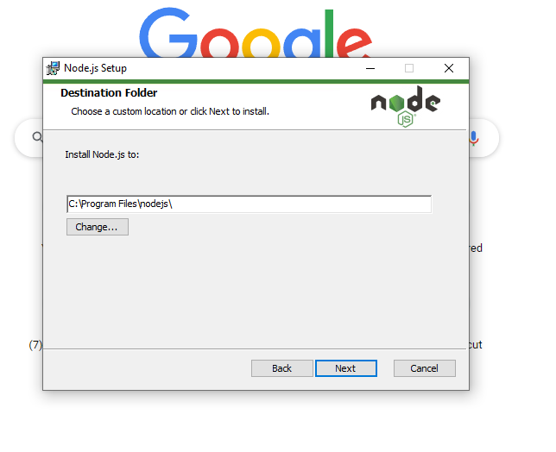
React Installation
NodeJS: You can download the latest version of Node.js installable archive file from https://nodejs.org/en/

Slide 5
Directory Structure
Assets Folder As the name says, it contains assets of our project. It consists of images and styling files. Here we can store our global styles. We are centralizing the project so we can store the page-based or component-based styles over here. But we can even keep style according to the pages folder or component folder also. But that depends on developer comfortability.
Layouts Folder As the name says, it contains layouts available to the whole project like header, footer, etc. We can store the header, footer, or sidebar code here and call it.
Components Folder Components are the building blocks of any react project. This folder consists of a collection of UI components like buttons, modals, inputs, loader, etc., that can be used across various files in the project. Each component should consist of a test file to do a unit test as it will be widely used in the project.
Pages Folder The files in the pages folder indicate the route of the react application. Each file in this folder contains its route. A page can contain its subfolder. Each page has its state and is usually used to call an async operation. It usually consists of various components grouped.

Slide 6
Directory Structure
Middleware Folder This folder consists of middleware that allows for side effects in the application. It is used when we are using redux with react. Here we keep all our custom middleware.
Routes Folder This folder consists of all routes of the application. It consists of private, protected, and all types of routes. Here we can even call our sub-route.
Config Folder This folder consists of a configuration file where we store environment variables in config.js. We will use this file to set up multi-environment configurations in your application.
Services Folder This folder will be added if we use redux in your project. Inside it, there are 3 folders named actions, reducers, and constant subfolders to manage states. The actions and reducers will be called in almost all the pages, so create actions, reducers & constants according to pages name.
Utils Folder Utils folder consists of some repeatedly used functions that are commonly used in the project. It should contain only common js functions & objects like dropdown options, regex condition, data formatting, etc.

Slide 7
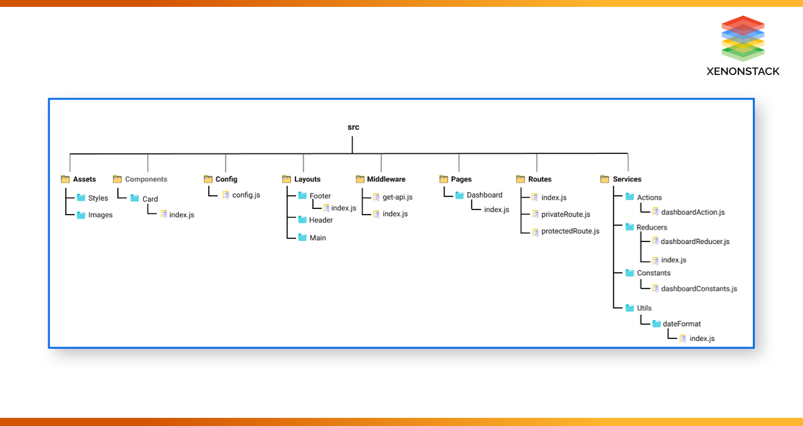
Directory Structure
Folder Structure

Slide 8
React Features
Currently, ReactJS gaining quick popularity as the best JavaScript framework among web developers. It is playing an essential role in the front-end ecosystem. The important features of ReactJS are as following.
JSX
Components
One-way Data Binding
Virtual DOM
Simplicity
Performance

Slide 9
React Features
JSX JSX stands for JavaScript XML. It is a JavaScript syntax extension. Its an XML or HTML like syntax used by ReactJS. This syntax is processed into JavaScript calls of React Framework. It extends the ES6 so that HTML like text can co-exist with JavaScript react code. It is not necessary to use JSX, but it is recommended to use in ReactJS.
Components ReactJS is all about components. ReactJS application is made up of multiple components, and each component has its own logic and controls. These components can be reusable which help you to maintain the code when working on larger scale projects.
One-way Data Binding ReactJS is designed in such a manner that follows unidirectional data flow or one-way data binding. The benefits of one-way data binding give you better control throughout the application. If the data flow is in another direction, then it requires additional features. It is because components are supposed to be immutable and the data within them cannot be changed. Flux is a pattern that helps to keep your data unidirectional. This makes the application more flexible that leads to increase efficiency.

Slide 10
React Features
Virtual DOM A virtual DOM object is a representation of the original DOM object. It works like a one-way data binding. Whenever any modifications happen in the web application, the entire UI is re-rendered in virtual DOM representation. Then it checks the difference between the previous DOM representation and new DOM. Once it has done, the real DOM will update only the things that have actually changed. This makes the application faster, and there is no wastage of memory.
Simplicity ReactJS uses JSX file which makes the application simple and to code as well as understand. We know that ReactJS is a component-based approach which makes the code reusable as your need. This makes it simple to use and learn.
Performance ReactJS is known to be a great performer. This feature makes it much better than other frameworks out there today. The reason behind this is that it manages a virtual DOM. The DOM is a cross-platform and programming API which deals with HTML, XML or XHTML. The DOM exists entirely in memory. Due to this, when we create a component, we did not write directly to the DOM. Instead, we are writing virtual components that will turn into the DOM leading to smoother and faster performance.

Slide 11
React Advantages
Easy to Learn and USe
Creating Dynamic Web Applications Becomes Easier
Reusable Components
Performance Enhancement
The Support of Handy Tools
Known to be SEO Friendly
The Benefit of Having JavaScript Library
Scope for Testing the Codes

Slide 12
React Disadvantages
The high pace of development
Poor Documentation
View Part
JSX as a barrier

Slide 13
React vs Angular Js
 | AngularJS | ReactJS
Author | Google | Facebook Community
Developer | Misko Hevery | Jordan Walke
Initial Release | October 2010 | March 2013
Language | JavaScript, HTML | JSX
Type | Open Source MVC Framework | Open Source JS Framework
Rendering | Client-Side | Server-Side
Packaging | Weak | Strong
Data-Binding | Bi-directional | Uni-directional
DOM | Regular DOM | Virtual DOM
Testing | Unit and Integration Testing | Unit Testing
App Architecture | MVC | Flux or Redux
Dependencies | It manages dependencies automatically. | It requires additional tools to manage dependencies.
Routing | It requires a template or controller to its router configuration, which has to be managed manually. | It doesn't handle routing but has a lot of modules for routing, eg., react-router.
Performance | Slow | Fast, due to virtual DOM.
Best For | It is best for single page applications that update a single view at a time. | It is best for single page applications that update multiple views at a time.

Slide 14
React vs React Native
React VS React Native
SN | ReactJS | React Native
1. | The ReactJS initial release was in 2013. | The React Native initial release was in 2015.
2. | It is used for developing web applications. | It is used for developing mobile applications.
3. | It can be executed on all platforms. | It is not platform independent. It takes more effort to be executed on all platforms.
4. | It uses a JavaScript library and CSS for animations. | It comes with built-in animation libraries.
5. | It uses React-router for navigating web pages. | It has built-in Navigator library for navigating mobile applications.
6. | It uses HTML tags. | It does not use HTML tags.
7. | It can use code components, which saves a lot of valuable time. | It can reuse React Native UI components & modules which allow hybrid apps to render natively.
8. | It provides high security. | It provides low security in comparison to ReactJS.
9. | In this, the Virtual DOM renders the browser code. | In this, Native uses its API to render code for mobile applications.

Slide 15
Q & A
Thank You ☺

